Slide 1
H₂O- Integrated Water Conservation System
By,
Amit Krishna A
&
Adith Shyam

Slide 2
Introduction
Water is a very important necessity of life. However, large amount of water is being wasted in our daily life with various domestic activities and have led to its shortage. H₂O has made it possible to save water in each and every pace of our daily life in a systematic and mechanized manner.

Slide 3
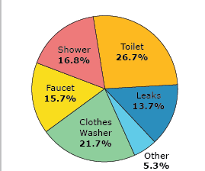
How much water do we use?

Slide 4
Components Used
Arduino Uno [Microcontroller based board]
BC547 NPN transistors
Motor Pump(3V-6V)
Ir Transmitter & Ir receiver
Soil Moisture
Wires, Pipes, Tubes & Stationeries

Slide 5
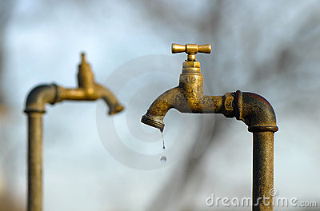
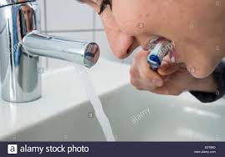
Exhibit -1: Automatic Tap
Objective
In our daily life lots of water is being wasted due to improperly closed taps, intended wastage and its other inefficient uses.
With H₂O, this wastage is reduced to a great extent with least manual efforts.
This could be used in Public Taps, Homes, Community Taps

Slide 6
Exhibit -1: Automatic Tap
Working
It consists of an ir transmitter and an ir receiver aligned to each other in a line.
The Ir Transmitter continuously transmits encoded data and Ir receiver receives and decodes it.
When we seek water this transmission is blocked.
The Arduino senses it and activates the pump to provide water.

Slide 7
Exhibit-2:Filtration unit and Automatic Pump
Large amount of water is wasted in our daily life due to motor overflow.
Further, mildly used water could be recycled to be used again using a filtration unit in this water scarce scenario.
H₂O,satisfies this by sensing the water remaining in the tank. It also filters and recycles the used water efficiently.

Slide 8
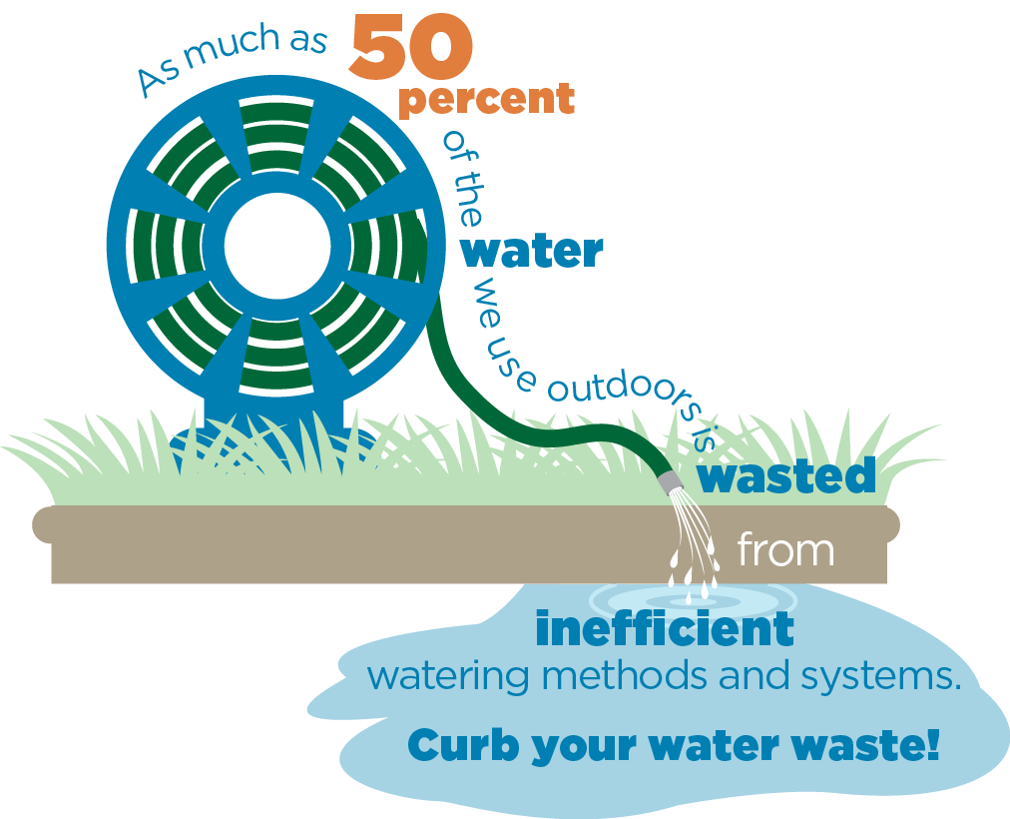
Exhibit-3: Automatic Irrigation System
Outdoor irrigation accounts for most of the water wastage in our daily life.
H₂O solves this by using its automatic irrigation mechanism.
It senses the moisture content by measuring the soil conduction and inputting it to the microcontroller which irrigates appropriately.

